Slide 1
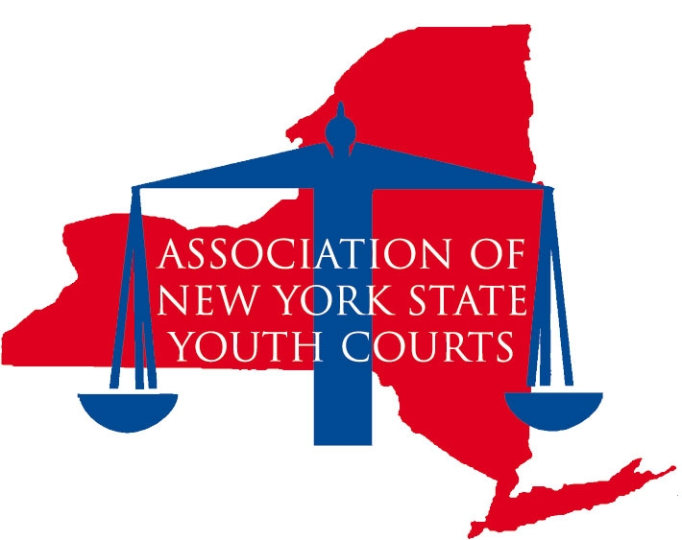
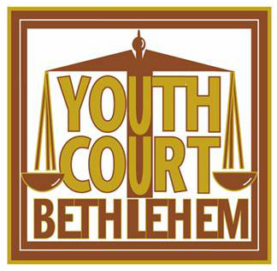
Katrina Charland
Executive Director, Bethlehem Youth Court
Secretary and Past Co-President, Association of New York State Youth Courts (ANYSYC)

Slide 2
ANYSYC (Association of New York State Youth Courts)
ANYSYC was established in 2001
Provides a network of Youth Courts across the state
Membership
Benefits include:
Travel reimbursements, voting privileges, discounts for conferences, access to scholarships for member volunteers, networking opportunities and more
Not all Youth Courts in NYS are members

Slide 3
NYS Law
A8024-A Establishes a Youth Court diversion program to transfer the dispositional phase of proceedings to Youth Courts.
Passed in 2011
Gives programs legal protection

Slide 4
NYS Youth Courts
About 70 programs in NYS
Most are community based
Address chargeable offenses
Work with youth who have had contact with law enforcement
Organizational models vary
Municipal, non-profits, Youth Bureaus, District Attorney’s Office, county based

Slide 5
Youth Court Models
Peer Jury
Tribunal
Adult Judge
Youth Judge
“If you’ve seen one youth court…you’ve seen one youth court.”

Slide 6
Commonalities and Variations
There are common core tenants in all NYS Youth Courts
Peer based
Restorative justice centered
Must have emphasis on restoring proper balance
Includes the offender, victim, and community
Community service
Civic engagement
The student volunteers and offenders benefit from this

Slide 7
Commonalities and Variations (Continued)
Programs vary from community to community
Benefits of this:
Allows each program to adapt to their community’s specific needs
What’s relevant in one area is not necessarily in another
Cannot be classified as “evidence based”
There is no program model that can be duplicated with same results necessarily in another region of the state

Slide 8
Referral Sources
District Attorney’s Office
Town Courts
Probation Departments
Police Departments
Direct Referrals
Schools

Slide 9
Common Offenses Heard
School based courts
Community based courts
Breaking school rules
Status offenses
Truancy cases
Cell phone use
Disrespect
Tardiness
Unlawful Possession of Alcohol/Marijuana
Petit Larceny
Fare evasion
Vandalism
Criminal Mischief
Harassment (bullying)

Slide 10
Common Sanctions/Stipulations
Community service hours
Educational classes
Peer pressure
Drug and alcohol
Anti-theft
Decision making
Anger management
Essays
Apology letters
Restitution
Counseling
Drug testing
Jury Duty

Slide 11
Dual Purpose
Providing young offenders with a second chance at a clean criminal record
Promotes accountability
Repairing the harm caused by crime/offenses
Reduce recidivism
Providing a great volunteer opportunity for youth in the community
Must attend a training program
Engages youth in civic responsibility
Connects volunteers with community members: lawyers, police, judges, etc.
Offenders
Volunteers

Slide 12
Benefits of Community Based Programs
Extends the opportunity for intervention beyond just schools, therefore it is a continuation of the prevention of the school to prison pipeline
Holds youth accountable in a meaningful and constructive way
Reduces case loads for traditional juvenile justice agencies
Gives back to local communities
Supports youth

Slide 13
Areas of Improvement
The ANYSYC is working to improve state-wide data collection and unification.
Programs are successful because they are tailored to fit each community’s specific needs, however, a more unified approach would bode well on the state level.

Slide 14
Recommendations for PA
Establish cohesive data collection standards from the onset
Create oversight, but not too restrictive
Pass legislation that gives protection for programs
Address the “school to prison” pipeline
Providing meaningful diversion reduces the school to prison pipeline
This could be a continuation from school based offenses to community based offenses with multiple opportunities for intervention

Slide 15
Conclusion
Promoting pro-social, civic involvement for volunteers as well as offenders
Developing positive community bonds helps decreases recidivism
Mentor relationships develop as a result of working side-by-side
Reestablishing faith in the “system”
Community members see first hand that youth related offenses are being directly addressed in a constructive way

