Slide 1
Pennsylvania Juvenile Justice Task Force Summary of Key Findings

Slide 2
Task Force Charge
“Our charge to this interbranch initiative is to develop data-driven policy recommendations through stakeholder consensus with the goals of:
protecting public safety,
ensuring accountability,
containing costs, and
improving outcomes for youth, families, and communities.”
Tom Wolf Governor | Thomas Saylor Chief Justice | Joseph Scarnati Senate President Pro Tempore (former) | Mike Turzai Speaker of the House (former)
Jay Costa Senate Minority Leader | Bryan Cutler Speaker of the House | Frank Dermody House Minority Leader (former) | Jake Corman Senate President Pro Tempore

Slide 3
Task Force Members
Sen. Lisa Baker (Co-chair), Senate District 20
Sen. Jay Costa (Co-chair), Senate District 43
Rep. Tarah Toohil (Co-chair), House District 116
Rep. Mike Zabel (Co-chair), House District 16
James Anderson, Former Executive Director (retired), Pennsylvania Juvenile Court Judges’ Commission
Andrew Barnes, Executive Deputy Secretary of Policy and Planning, Office of Governor Tom Wolf
Kevin Bethel, Special Adviser for School Safety, School District of Philadelphia
Meghan Black, Deputy District Attorney, Allegheny County
Rep. Karen Boback, House District 117
Quimon Broady, Youth Member
Russell Carlino, Chief Probation Officer, Juvenile Probation Department, Allegheny County
Judge Kim Berkeley Clark, 5th Judicial District
Dominick DiSalvo, Senior Director of Clinical Services, KidsPeace
Cynthia Figueroa, Deputy Mayor, Office of Children and Families, City of Philadelphia
Steven Guccini, Commissioner, Pike County
Helen Gym, Councilwoman At-Large, Philadelphia City Council
Rep. Kristine Howard, House District 167
Dan Jurman, Executive Director, Office of Advocacy and Reform
Sen. Scott Martin, Senate District 13
Haundray Muir, Youth Member
Michael Pennington, Executive Director, Pennsylvania Commission on Crime and Delinquency
Tara Piechowicz, Deputy Secretary of Policy and Planning, Office of Governor Tom Wolf
Judge Douglas Reichley, Lehigh County Court of Common Pleas
Jonathan Rubin, Deputy Secretary, Office of Children, Youth, and Families, Pennsylvania Department of Human Services
Tiffany Sizemore, Assistant Professor of Clinical Legal Education, Duquesne University School of Law
Richard Steele, Executive Director, Pennsylvania Juvenile Court Judges’ Commission
Matthew Stem, Deputy Secretary, Office of Elementary and Secondary Education, Pennsylvania Department of Education
Scott Talley, Director, Office of Mental Health and Substance Abuse Services, Bureau of Children’s Behavioral Health Services, Pennsylvania Department of Human Services
Joseph Werner, School Social Worker, Pennridge School District
Sen. Anthony H. Williams, Senate District 8

Slide 4
Timeline and Process
July - October
Data Analysis
System Assessment
October
October - January
January - May
Policy Development
Final Report
Begin Policy Development Subgroups
Policy Consensus
Research Review
Data Follow-Up
Stakeholder Engagement

Slide 5
Key Data Findings
Research shows over-involving kids in the juvenile justice system can lead to worse outcomes.
Most youth enter the juvenile justice system for low-level offenses and score as low risk to reoffend.
Yet a majority are not diverted from court.
Diversion from court is more than 80% successful

Slide 6
Pennsylvania school law enforcement referral and arrest rates higher than neighboring states
Note: The 2015-2016 school year is the most recent data available.

Slide 7
Fighting, tobacco or drug incidents, and disorderly conduct are the top school infractions referred to law enforcement
Rank | Top 10 Infractions (2019): Law Enforcement (LE) Notification | % of LE Notifications
1 | Fighting | 20%
2 | Possession/Use or Sale of Tobacco or Vaping | 10%
3 | Possession/Use of a Controlled Substance | 10%
4 | Disorderly Conduct | 9%
5 | Simple Assault on Student | 8%
6 | Student Code of Conduct | 7%
7 | All Other Forms of Harassment/Intimidation | 4%
8 | Threatening School Official/Student | 4%
9 | Possession of Knife | 4%
10 | Sale/Possession/Use or Under the Influence | 2%
 | Total | 78% (100%)
Source: Pennsylvania Department of Education

Slide 8
Most youth enter the juvenile justice system for misdemeanors, failure to pay fine in Magisterial District Court
 | Most Serious Offense (Grade) | Percent Written Allegations in 2018
1 | Contempt from MDJ (Non-Payment) (C) | 18%
2 | Simple Assault (M) | 10%
3 | Possession of Drugs (M) | 10%
4 | Theft-Related Offense* (M) | 6%
5 | Terroristic Threats (M) | 5%
6 | Aggravated Assault (F) | 5%
7 | Theft-Related Offense* (F) | 5%
8 | Robbery (F) | 3%
9 | Possession with Intent to Deliver Drugs (F) | 3%
10 | Burglary (F) | 3%
 | Total | 67% (100%)
*A theft-related offense includes: theft, theft by unlawful taking, theft by deception, theft by receiving stolen property, and theft from a motor vehicle; F= Felony, M= Misdemeanor
Source: Juvenile Court Judges’ Commission

Slide 9
Nearly two-thirds of written allegations for kids assessed as low risk to reoffend did not result in diversion from court
Source: Juvenile Court Judges’ Commission

Slide 10
Even among misdemeanors for kids with no prior written allegations, 54% do not result in diversion from court
Source: Juvenile Court Judges’ Commission

Slide 11
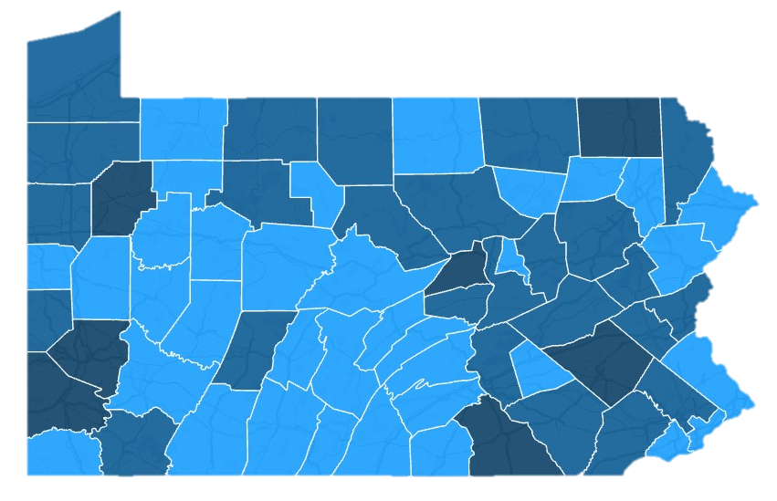
Percentage of Written Allegations with Pre-Petition Diversion as First Court Response: 2018
Fewer than 25% of written allegations are diverted from court in half the counties in Pennsylvania
0% - 25%
26% - 50%
51% - 75%
Source: Juvenile Court Judges’ Commission

Slide 12
Key Data Findings
Research shows out-of-home placement does not reduce recidivism for most youth.
Yet most young people in Pennsylvania sent to out-of-home placement are:
sent on their first adjudicated offense;
sent for misdemeanors and nonperson offenses; and
do not score high or very high risk to commit another offense.

Slide 13
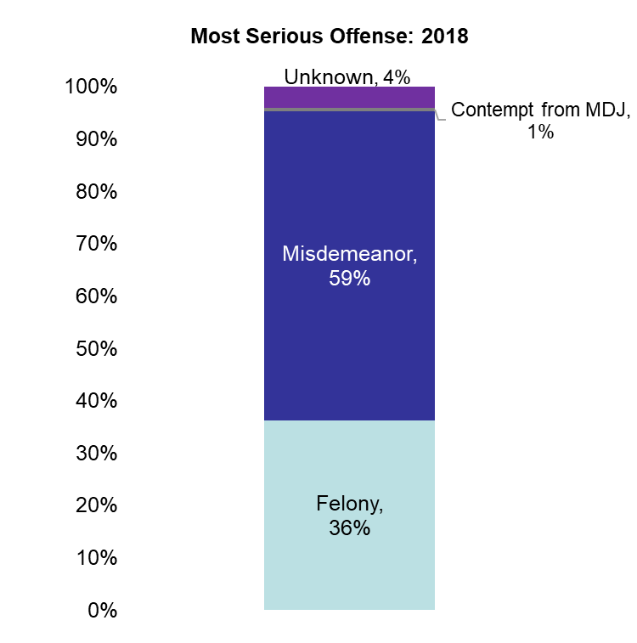
Just 36% of out-of-home placements are for felonies

Slide 14
Most youth sent to out-of-home placement have no prior adjudicated offenses
Source: Juvenile Court Judges’ Commission

Slide 15
Key Data Findings
Youth are kept under court supervision—and in out-of-home placement—for years
Youth with placement dispositions:
average six out-of-home placements over the course of their case
cumulatively stay 16 months out of home, on average, (one-in-five stay over two years); and
average more than three years under overall court supervision

Slide 16
Almost half of youth with placement dispositions spend time in five or more out-of-home placements
Average: 6 out-of-home placements
*These figures include the total number out-of-home placements that youth with placement dispositions experience. Out-of-home placements include detention, shelter, and residential placements.
Source: Juvenile Court Judges’ Commission

Slide 17
Cumulatively, youth sent to out-of-home placement spend 16 months out-of-home, on average; 18% spend over two years
Average: 16 months
*Includes total time spent in detention facilities, shelter facilities, and residential placement facilities. Total cumulative length of time out of home is calculated by summing together the length of time at each placement.
Source: Juvenile Court Judges’ Commission
Notes:
And when youth are placed outside the home, they can expect to stay, on average, 16 months in those various facilities.
No variation by race [cut slide], but variation by gender and race+gender
The universe of kids here just those with placement dispositions – but their detention and shelter admissions are included as well
Medians
2014: 11 Months
2015: 12 Months
2016: 12 Months
2017: 12 Months
2018: 12 Months
Min: 1 Month
Max: 161 Months [but again seems like a data entry error, so 90, 88, 81, 77, and 76 are the next highest]

Slide 18
Key Data Findings
Most Pennsylvania taxpayer spending on delinquency services is allocated to out-of-home placement—totaling at least $280,000,000 in FY19
Just 20% of Pennsylvania’s spending on delinquency services is allocated to services for youth living at home

Slide 19
Out-of-home placement costs vastly exceed those of nonresidential services shown to reduce reoffending

Slide 20
Key Data Findings
Youth of color—especially boys—are more likely to be:
removed from home, even for identical offenses as other youth;
kept longer out of home and under the overall court supervision; and
prosecuted as adults

Slide 21
Black females are three times more likely than white females to be involved in incidents with law enforcement notification
Source: Pennsylvania Department of Education
Note: “Other” includes Multi Racial, American Indian, and Alaskan Native. “Asian” includes Native Hawaiian and Pacific Islander.

Slide 22
Black boys more likely to be removed from home—even for identical offenses
*Pennsylvania youth population data were retrieved from the Centers for Disease Control and Prevention; Asian Non-Hispanic youth and Other Non-Hispanic females are excluded from this analysis due to their small numbers

Slide 23
Key Data Findings
Records associated with a youth’s juvenile justice system involvement do not automatically disappear in adulthood, even if their case is dismissed or withdrawn
Those arrest and court records may have lasting detrimental consequences, affecting employment prospects, military enlistment, among many other areas
The vast majority of cases eligible for expungement are not expunged

Slide 24
The vast majority of eligible cases are not expunged, including 96% of eligible adjudicated cases
Notes:
Tab 1

Slide 25
Task Force Recommendations
Focus resources on kids who may pose the highest risk to community safety by diverting less serious cases from court and from placement.
Reinvest cost savings from out-of-home placement reductions into a continuum of nonresidential services and interventions in every county
Increase accountability through stronger oversight

Slide 26
Contact Information
Task Force Website: http://www.pacourts.us/pa-juvenile-justice-task-force
Senator Lisa Baker
Email: lbaker@pasen.gov
Senator Jay Costa
Email: jay.costa@pasenate.com
Representative Tarah Toohil
Email: ttoohil@pahousegop.com
Representative Mike Zabel
Email: mzabel@pahouse.net
Noah Bein
The Pew Charitable Trusts, Public Safety Performance Project
Phone: (202) 680-3728
Email: nbein@pewtrusts.org

