Slide 1
Middle School Youth Court
Paul Gladfelter
Chris Patterson
John Dolan

Slide 2
What is a Youth Court in a school?
Youth court is a student run restorative justice program that gives students that make a poor choice an opportunity to improve their behavior without being suspended or punished in the traditional way. Youth Court is a student run organization that can help other students become responsible for their behavior and make better choices in the future. The goal of youth court is to help students take responsibility for their actions/behaviors and to teach strategies for students to become more successful.
The School District of Philadelphia

Slide 3
What benefits do Youth Courts give students, schools, and communities?
Students who are involved in the program as members of the court system have an opportunity to have some ownership in the building and some say about restorative practices in the building.
Provides opportunities to learn and partake in how the legal system works.
Provides lifetime skills like leadership skills, communication, problem solving, working together, mentoring, displayed empathy, developing higher level thinking skills and teamwork that can be used in and out of school.

Slide 4
What benefits do Youth Courts give students, schools, and communities?
Provides students with feedback from their peers on discipline issues and enhances the students “voice” while improving relationships between students and between teachers and students.
Youth Courts utilize positive peer pressure to encourage students to help their friends and their peers make good decisions.
Students who do not graduate from high school are eight times more likely to end up in jail or prison. Youth Court can help and encourage behavior change and a connection to the school.
Youth Courts keep student offenders in school where they belong!

Slide 5
What is Restorative Justice?
In restorative justice, the point is to repair harm and prevent the offense from happening again, not to create more harm by punishing the offender.
The people affected by the hurt behavior should be involved in its resolution. This includes offenders, victims and other school-community members.

Slide 6
Effectiveness of a Youth Court
Students “learn by doing” (Dewey).
Students are more engaged because they are actively participating in running the court with no outside help.
Students become empowered and own the Youth Court.
Many students have experienced trauma in their lives, and we don’t want to retraumatize students by punishing them and making them feel even worse. We want to help them and hold them accountable.

Slide 7
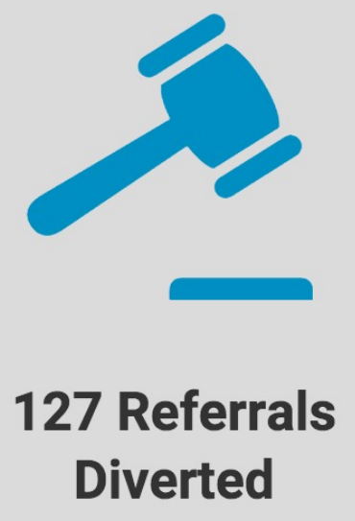
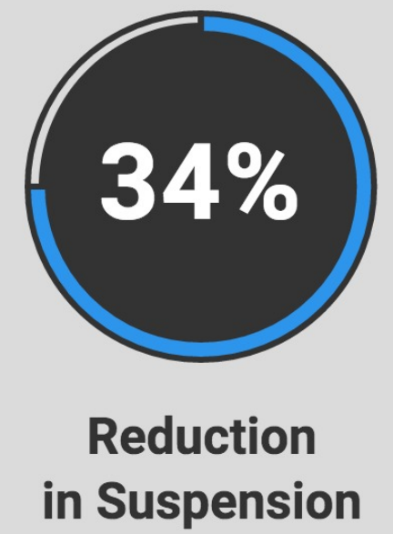
Youth Court:
In one school year, a school district saw:

Slide 8
What discipline issues will the court address?
The court will only work with students who admitted their quilt and for Level 1 and 2 violations. Parents will also be asked if they wish to have their child work with the Youth Court for discipline issues. If a parent does not choose for their child to work with the court, Principal/Assistant Principal will work with the student.
Examples of Level 1 violations:
Tardiness, Misuse of passes, Cutting class, Inappropriate language, Minor classroom/ school misconduct, Minor defacing of school property
Example of Level 2 violations:
Repeat of level 1 violation, Leaving school/class without permission, Academic Dishonesty, Bus misconduct, School misconduct, Failure to complete discipline from previous violation.

Slide 9
How the Courts will run
Before the case is given to the court, the student must already admit their guilt.
Set-up: Before the court begins the Judge and role of the members need to be assigned. The room needs to be set-up.
Introduction: Judge introduces the court, the bailiff administer the oath, bailiff read the written statement. Youth advocate makes the opening statement, respondent explains what happen.
Questions: The questions are asked from the court to the respondent.
Deliberation: After questioning, the bailiff would then escort the youth advocate and respondent from the room. Deliberation occurs with the jury. Discipline can be suggested such as apology (written and verbal), a conference, and community service, along with other options. The court would vote on each of the disposition ideas.
Follow-up: Check in with the respondent about the disposition.

Slide 10
Timetable
Training would start with staff in the summer, training for students during the school year. The court proceedings would take place around November/December after all the training are completed.

Slide 11
Thank You for your time and attention. Are there any questions?

