Slide 1
Literature Based Programing
PRESENTED BY
www.rendellcenter.org

Slide 2
Read Aloud Goals
Promote Civic Literacy: Increase awareness and understanding of civics among our youngest citizens through engaging read-aloud sessions for k-5 students
Foster Patriotism and Civic Pride: Cultivate a sense of belonging and pride in one’s country by exploring the historical and cultural significance of civic holidays (Constitution Day, Election Day, Veterans Day, Bill of Rights Day, Presidents Day, Law Day)
Foster Critical Thinking: Encourage participants to analyze and evaluate civic issues, promoting critical thinking skills essential for informed citizenship.
Cultivate a Culture of Civic Engagement: Inspire active participation in community affairs, democratic processes, and social justice initiatives as students interact with volunteer readers (lawyer, judge, veteran, First Responder)
Bridge Divides: Facilitate constructive dialogue and understanding among diverse communities, fostering empathy and mutual respect. This can be seen in the Veterans Read Aloud, First Responder Read Aloud and, in the Attorney/ Judge volunteers.
Enhance Literacy Skills: Improve students’ literacy skills, including listening comprehension, vocabulary development, and critical thinking, through interactive read-aloud experiences.

Slide 3
About the Program:
The Law Day Read Aloud Program is a unique opportunity for lawyers to engage with elementary school students through the power of storytelling. By volunteering as a reader, you’ll have the chance to share your passion for law and justice in a fun and interactive way. We have found the virtual format works well for the teacher/class because it enables all to see the book and follow along with the reading, and it suits volunteers, too, because it requires only 30 minutes of your time and best of all you do not have to leave the office!
The process we have found that works best for a Rendell Center virtual Read Aloud session is for the attorney/judge to read the book via Zoom while in their office, a law library, or even in a courtroom. When the reading concludes, the attorney/judge leads the class in a brief discussion about citizenship and the Rule of Law (based on a lesson that we have prepared and will provide to you in advance). A member of our staff will join you for the lesson, managing the PowerPoint of the book, helping to get the discussion started, and keeping things moving along.

Slide 4
Why Participate:
Make a Difference: Inspire the next generation and instill a love for learning.
Promote Civic Education: Foster understanding of legal concepts and civic responsibility.
Connect with Your Community: Build meaningful relationships with students and educators.
Celebrate the Constitution, the Judiciary, and the Rule of Law.

Slide 5
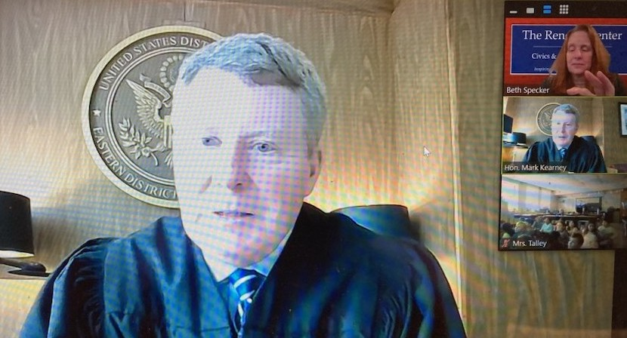
How it Works:
Sign Up: Go to https://rendellcenter.org/law-day-read-aloud/
Choose: Your session on our virtual scheduling Calendar.
Prepare: Receive zoom link and the PowerPoint from the Rendell Center.
Engage: Share your expertise and lead discussions with students.

Slide 6
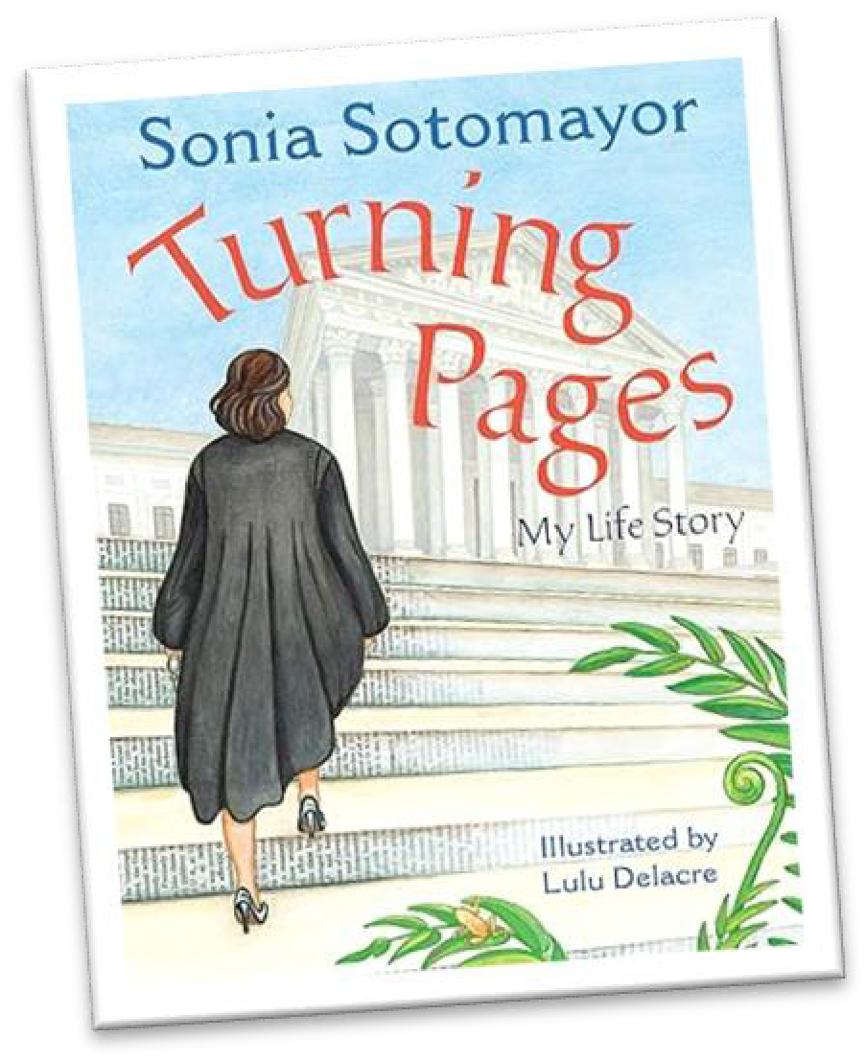
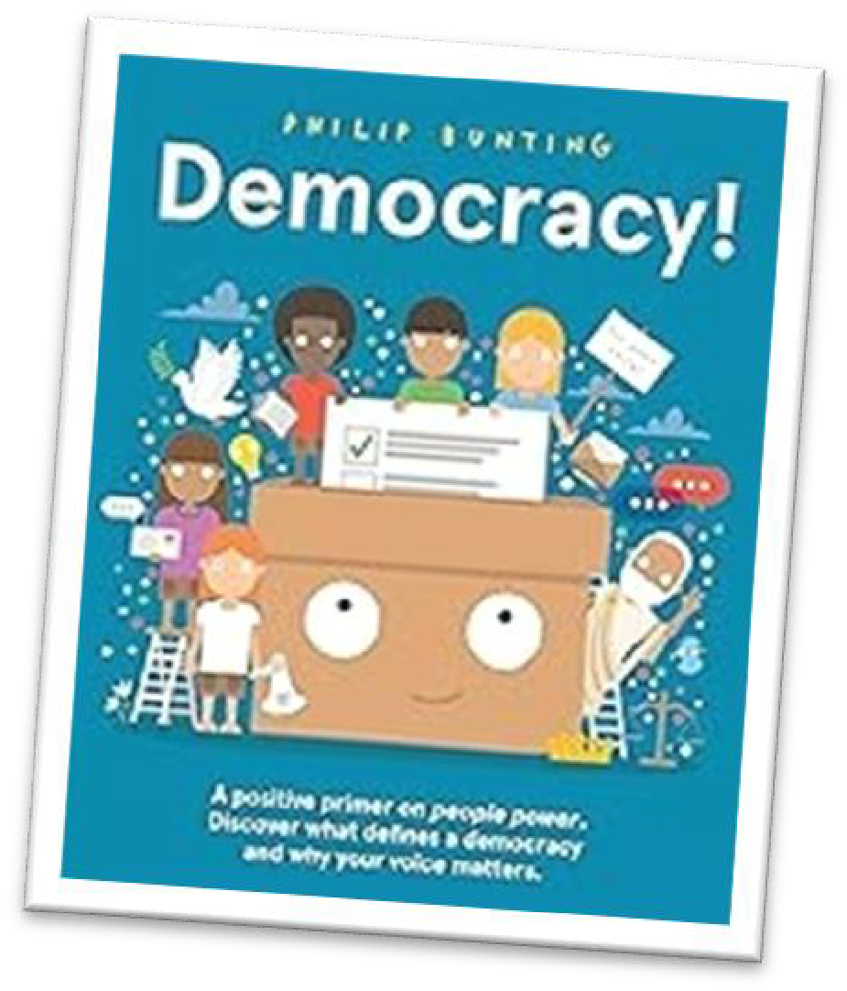
LAW DAY READ ALOUD PROGRAM 2025
JOIN US IN INSPIRING YOUNG MINDS AND CELEBRATING JUSTICE!
April 28 - May 2, 2025 . The Law Day theme this year is:
The Constitution's Promise: Out of Many, One

Slide 7
Read-Alouds and Lessons for Our Young Citizens
Books Themes
The Big Orange Splot by D. Pinkwater Becoming a Change Agent
Sofia Valdez, Future Prez by Andrea Beaty Our Future Leaders
I Could Do That by Linda Arms White Women and the Vote
I Dissent: RBG Makes Her Mark by Debbie Levy Being a Change Agent
More Than Anything Else by Marie Bradby Leaders Setting Goals
Daft Bat by Jeanne Willis Different Points of View
The Day the Crayons Quit by Drew Daywalt Making Positive Change
The Other Side by Jacqueline Woodson Becoming a Change Agent
Pies from Nowhere by Dee Romito Becoming a Change Agent
Midnight Teacher by Janet Halfmann The Power of Education
We Are the Change Childrens Book Words to Inspire Leadership and Change
Shaking Things Up by Susan Hood Young Women Who Changed the World

Slide 8
continued…)
Books Themes
Bella’s Rules by Elissa Guest Why We Have Rules
Carl the Complainer by Michelle Knudsen A Call to Action
The Proudest Blue by Ibtihaj Muhammad Being Proud of Who You Are
The Pink Hat by Andrew Joyner The Art of Peaceful Protest
Uncle Willie & the Soup Kitchen by Dyanne Young Citizens Called Into Action
I Could Do That by Linda Arms White Women’s Right to Vote
The Youngest Marcher by Cynthia Levinson Young Activists
What Do You Do With An Idea? by Kobi Yamada Finding Your Voice
Henry’s Freedom Box by Ellen Levine The Value of Our Freedom
Questions will generate rich conversations in disciplines across the curriculum as well as throughout
the grade levels. The lessons are all on the Rendell Center website: www.rendellcenter.org.

Slide 9
Read-Alouds and Lessons
Bringing complex concepts into the K to 8 Classroom
In the book Carl the Complainer, we see a young boy changing what he and his friends see as an unjust local law through petition.
We see the entire process, from the creation of a petition to the canvassing of signatures, to speaking on its behalf at a Town Hall Meeting.

Slide 10
Sample questions for Carl the Complainer
What are some changes you might like to see in your school or neighborhood?
What might be the first step towards achieving your goal?
Who in your community might be a good person to ask for help?

